Slide 1


BASIC COMPUTER SKILLS

Slide 2
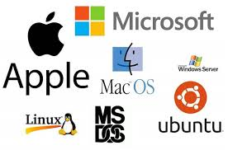
What is an Operating System (OS)?
An Operating System (OS) is like the brain of a computer. It helps the computer work properly by managing all the hardware (like the keyboard, screen, and memory) and software (like apps and games).
Navigating the OS:
Windows: Use the Start menu to access applications, files, and settings.
Mac: Use the Dock or Launchpad for easy access to applications.

Slide 3

Think of it as a traffic controller that makes sure everything runs smoothly. It:
Starts the computer when you turn it on
Runs apps and programs (like YouTube, Word, or a game)
Saves and finds files (like photos or documents)
Connects to the internet and other devices (printers, USB drives)

Slide 4
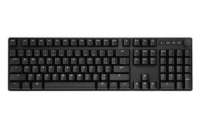
Keyboard
A keyboard is an important input device that helps you type text, give commands, and control your computer.
shortcuts:
✅ Ctrl + C → Copy
✅ Ctrl + V → Paste
✅ Ctrl + X → Cut
✅ Ctrl + Z → Undo
✅ Ctrl + S → Save
✅ Ctrl + P → Print

Slide 5
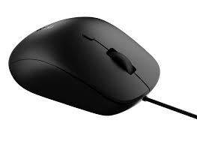
Mouse
A basic computer mouse has these important parts:
🔹 Left Button – Click to select or open things. 🔹 Right Button – Opens a menu with extra options. 🔹 Scroll Wheel – Moves up and down on a page. 🔹 Mouse Sensor (Bottom Side) – Helps the mouse track movement.

Slide 6
Single Click (Left Click)
Press and release the left button once.
Used to select an item (e.g., clicking on a file or button).
Double Click
Quickly press the left button twice.
Used to open files, folders, and apps on the desktop.

Slide 7
Right Click
Press the right button once to open a menu with extra options.
Example: Right-click on a file to see options like "Rename" or "Delete".
Drag and Drop
Click and hold the left button, move the mouse, and then release it.
Used to move files, rearrange icons, or draw in programs.
Scrolling
Move the scroll wheel up or down to navigate through a page.
Useful when reading long documents or browsing the web.

